Slide 1

COMMUNITY FOODBANK OF NEW JERSEY DATA ANALYSIS

Slide 2
Content
Business Case – Predict poverty across the United States at the county-level from other socioeconomic indicators to allocate their limited resources more efficiently by indicating the most impactful features of Area, Economic, Demographic, and Health .
Data Acquisition – Donor data was obtained in CSV format
Data Preparation – Missing data was found using a dataprep package in python and steps were taken to fill the gaps or remove significant missing data
Data Visualization – Graphs were created using Power BI, and the SweetViz python package to understand the relation of feature to the rank

Slide 3
Data Preparation
Total number of areas recorded = 3,198
No duplicate values found
Following missing values were found:
Homicides per 100k (61.5% missing)
% Excessive Drinking (30.6% missing)
% Adult Smoking (14.5% missing)
Motor Vehicle Crash Deaths per 100k (13.0% missing)
Remaining values have 10% or less missing values
Missing values treatment:
% Adult Smoking and Motor Vehicle Crash Deaths per 100k : Since the records out of are missing far less than <20% of the total data we have decided to ignored the missing values due to the negligible effect on the outcome
% Excessive Drinking and Homicides per 100k were kept from correlation analysis due to each missing more than 20% of records

Slide 4
Exploratory Data Analysis
The Features (i.e., variables) are segregated into three Categories namely:
Dependent Variable (Y) – This is the Poverty Rate which is to be predicted
Noise Features : Variables which would not have a significant impact on the value of Poverty Rate
Redundant
Feeder variables
Predictor Variables : Variables which were considered to have an impact on the Poverty Rate

Slide 5
Exploratory Data Analysis (contd..)
Noise Variables
Predictor Variables
Rural-Urban Continuum Codes | Percent of adult population that is physically inactive | Percent of population that identifies as Hispanic and White
Urban Influence Codes | Fine particulate matter in µg/m³ | Percent of population that identifies as Native American
County Typology Codes | Deaths by motor vehicle crash per 100,000 population | Percent of population that identifies as Asian
Civilian labor force, annual average | Population per dentist | Percent of adult population that does not have a high school diploma
Unemployment, annual average | Population per Primary Care Physician | Percent of adult population which has a high school diploma as highest level of education achieved
Percent of adults without health insurance | Percent of population that is female | Percent of adult population which has some college as highest level of education achieved
Percent of children without health insurance | Percent of population that is below 18 years of age | Percent of adult population which has a bachelor's degree or higher as highest level of education achieved
Percent of adults who meet clinical definition of obese | Percent of population that is aged 65 years or older | Births per 1,000 of population
Percent of population with diabetes | Percent of population that identifies as Hispanic | Deaths per 1,000 of population
Percent of babies born with low birth weight | Percent of population that identifies as African American | Percent of adults who smoke
ID
Percent of adult population that engages in excessive consumption of alcohol
Deaths by homicide per 100,000 population

Slide 6
Data Visualization
Data visuals are created using Power BI where charts are plotted using the independent variables against the dependent variable (Poverty Rate).
These charts help us in getting a preliminary idea about the relationship between the independent variables and the dependent variable (Poverty Rate).

Slide 7
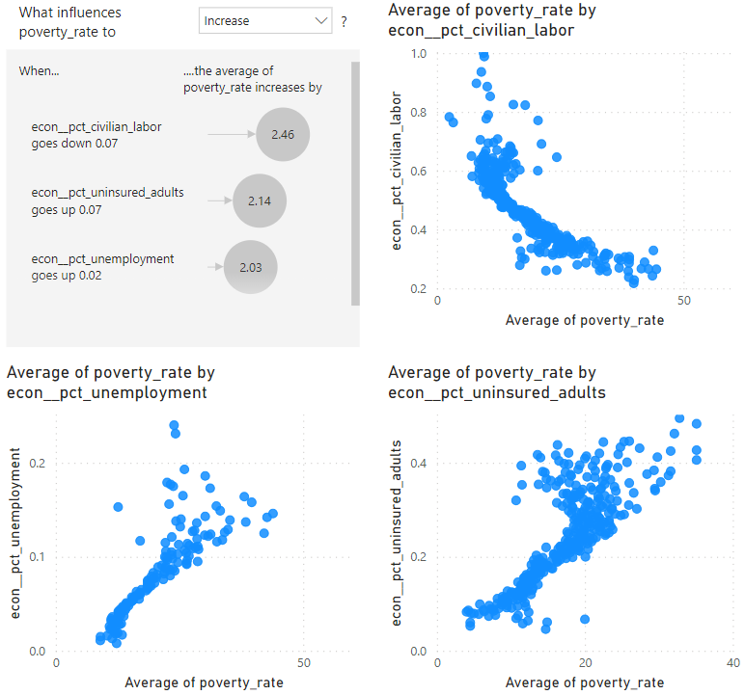
Economic Features
Key Highlights
The most impactful economic features appears to be the amount of civilian labor force available
All economic features seem to have less impact than the other fields of features

Slide 8
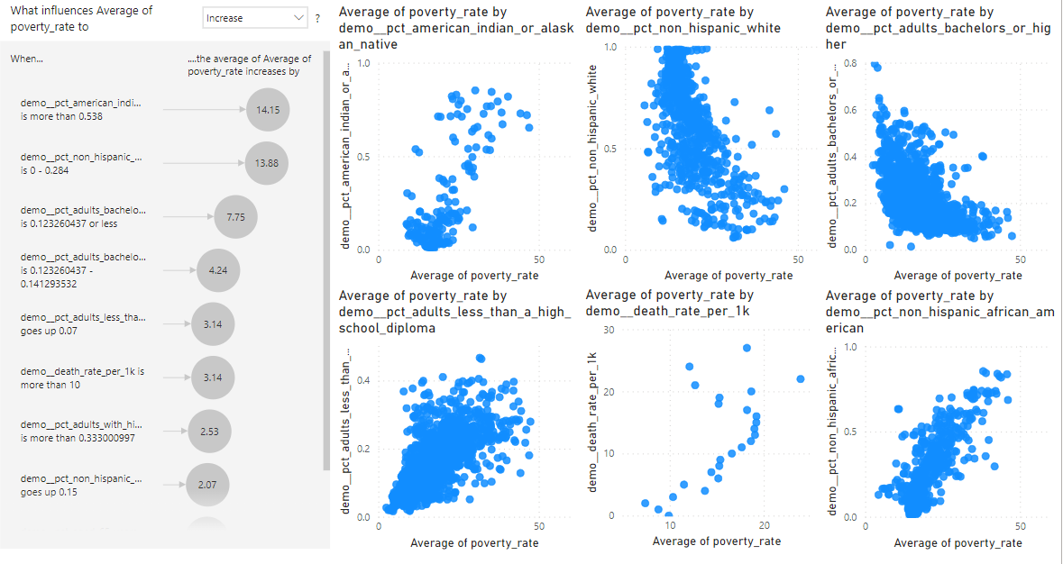
Demographic Features
Key Highlights
Demographics seems to have the highest impact of any category of features.
Primarily ethnic and racial backgrounds have significant impacts and all are unfortunately factors are not changeable
Other significant factors include education level and population per healthcare providers which are factors that are mutable

Slide 9
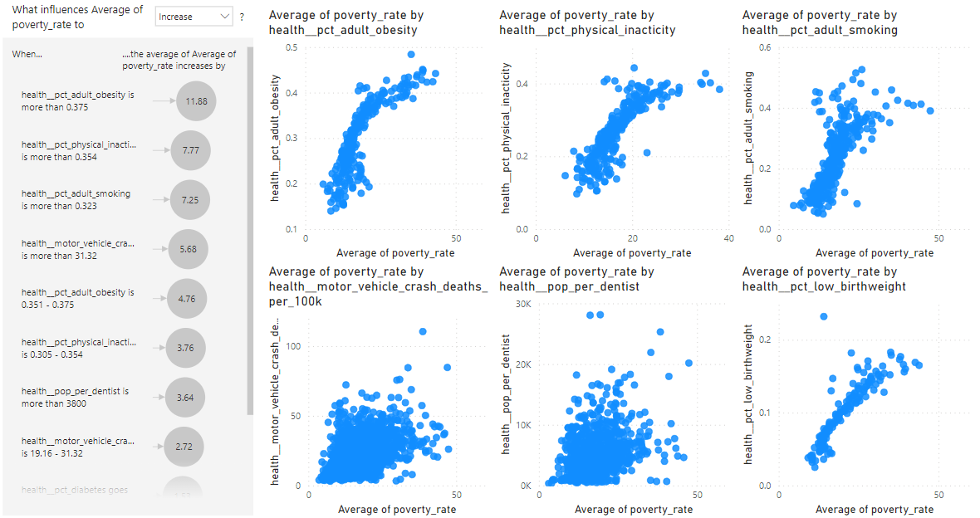
Health Features
Key Highlights
Health seems to have the 2nd highest impact of any category of features.
Primarily obesity, inactivity, and smoking have been impacts and all are fortunately factors are changeable at the individual level

Slide 10
Highest Correlation Features
Correlation Value | Variable
-0.67 | Civilian labor force, annual average
0.59 | Unemployment, annual average
0.54 | Percent of adults without health insurance
0.51 | Percent of population that identifies as African American
-0.50 | Percent of population that identifies as Hispanic and White
0.68 | Percent of adult population which has a high school diploma as highest level of education achieved
-0.47 | Percent of adult population which has a bachelor's degree or higher as highest level of education achieved
0.44 | Percent of adults who meet clinical definition of obese
0.40 | Percent of adults who smoke
0.54 | Percent of population with diabetes
0.57 | Percent of babies born with low birth weight
0.44 | Percent of adult population that is physically inactive
0.42 | Deaths by motor vehicle crash per 100,000 population
Key Highlights
The Poverty Rate only seems to have high levels of correlation with many of the features in the dataset
Level of education and the labor force available can be seen as some of the most impactful features.

Slide 11
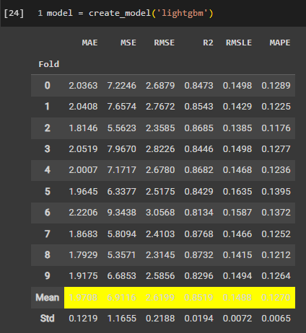
Machine Learning Algorithm Method
Key Highlights
The lightGBM Machine Learning Method had the best score in predicting the poverty rate with a mean absolute error of 1.97. This is considered very accurate.

